Slide 1
Convolutional Neural Network

Slide 2
Why CNN ?
Our image has a large number of size , so it creates much input features for the neural network. So, there are lots of parameter to train .
-for this our CPU or GPU wont be able to handle it properly sometimes.
-High times required
-more number of neurons ,more number of weight parameter
->this means OVERFITTING
-It can effect our performance

Slide 3
To overcome , we use CNN.
Main idea behind the CNN is Filter.
Filter :
-Sliding Window
-Detect the features and pattern
-Filter can be vertical or horizontal detector

Slide 4
Convolution Layer:
This is the core building block of CNNs
This is the filtering layer.
A convolution operation involves a filter (kernel) over the input image to extract features such as edges, textures, and shapes.
After completing filtering an Activation function (ReLU) is applied to handle the negative value.

Slide 5
Convolutional Operation

Slide 6
Filtering
Input Image
Feature map
Filter (Sliding Window)
X
F X F X C
N X N X C
Feature map size
(nxn) * (fxf) = (n-f+1) X (n-f+1)
C = number of channel
This number must be matched with the filter channel

Slide 7
How it Works
Filter detect edges all around image
Edges pass
Detect features associated with image [eye, nose, ear etc.]
Detect entire face of the image by combining features
Associate with a particular label [Human / Animal]

Slide 8
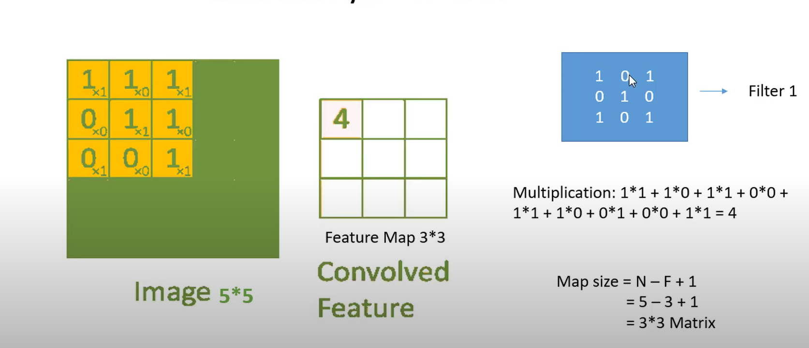
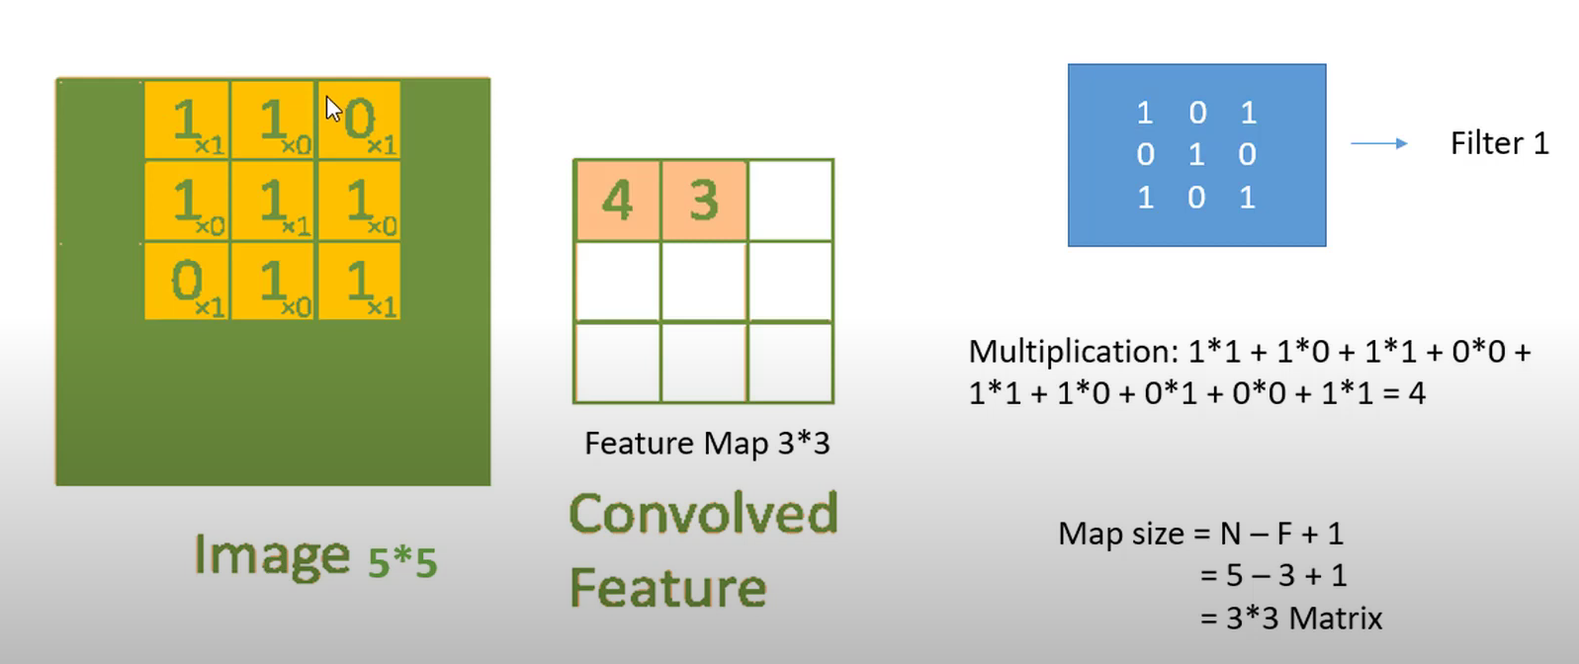
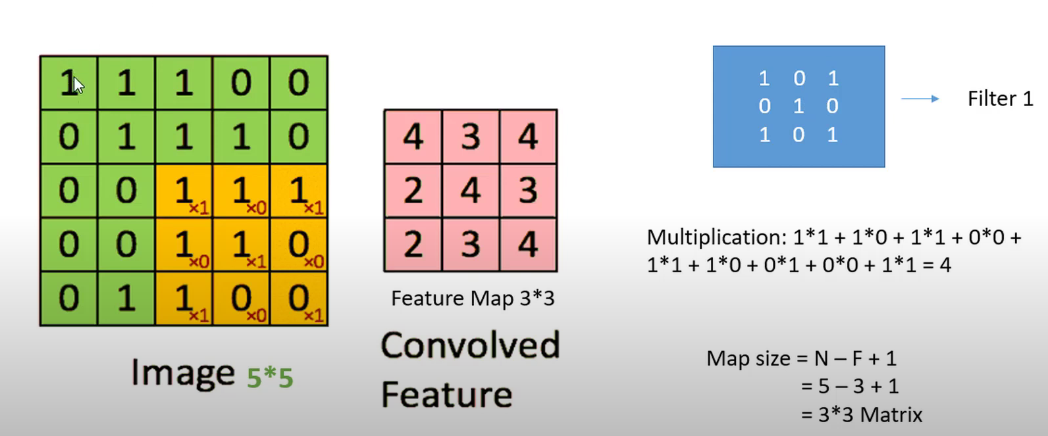

Slide 9
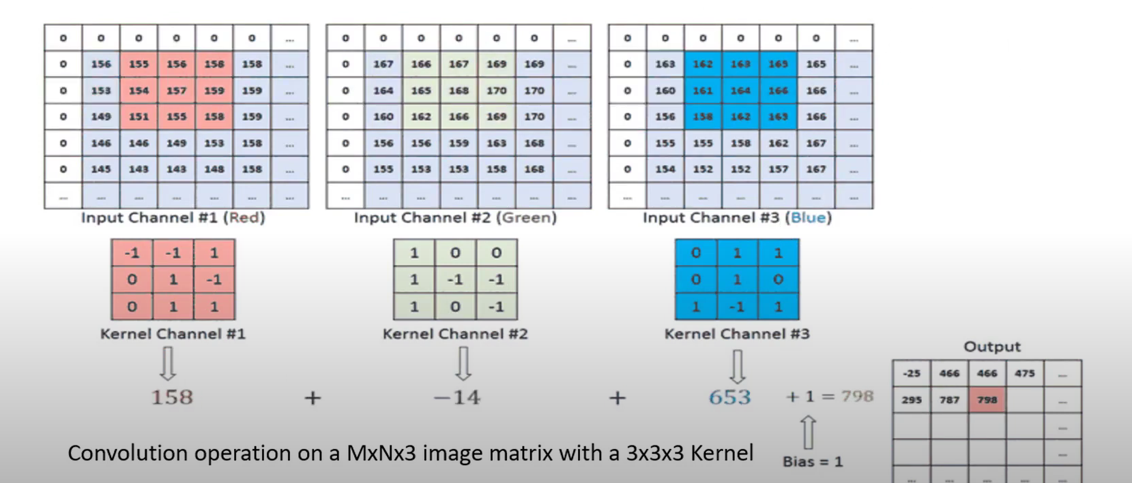
For RGB Channel

Slide 10
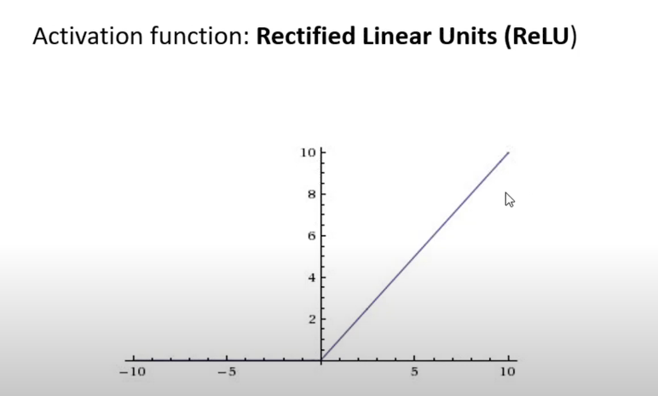

Slide 11
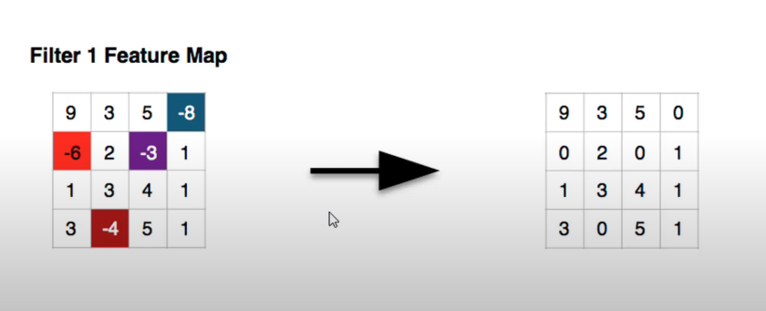
ReLU use for convert all the negative pixels value to ZERO(0) after Convolution layer

Slide 12
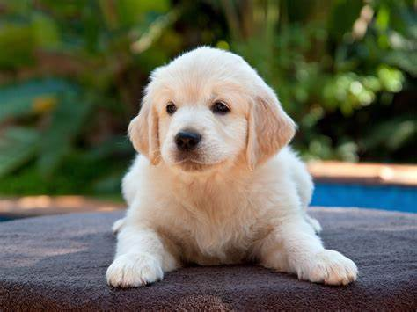
Applied ReLU Activation function after Convolutional Layer with Multiple Filter
f x f x3
X
ReLU ( +bias1)
f x f x3
X
ReLU ( +bias1)
f x f x3
X
ReLU ( +bias1)

Slide 13
Padding :
Padding is not always necessary
0 | 0 | 0 | 0 | 0 | 0 | 0 | 0 | 0
0 |  |  |  |  |  |  |  | 0
0 |  |  |  |  |  |  |  | 0
0 |  |  |  |  |  |  |  | 0
0 |  |  |  |  |  |  |  | 0
0 |  |  |  |  |  |  |  | 0
0 |  |  |  |  |  |  |  | 0
0 |  |  |  |  |  |  |  | 0
0 | 0 | 0 | 0 | 0 | 0 | 0 | 0 | 0
All the Corner Pixels traverse only one time. So The corner part doesn’t get proper attention while filtering the image. So for the large full image it might impact out model.
So the idea behind it to overcome is to do Padding.
7 X 7
Here input image size after padding = n*2p
= 7+2*1
= 9
Now all the corner pixels get enough number of traversal
9 X 9

Slide 14
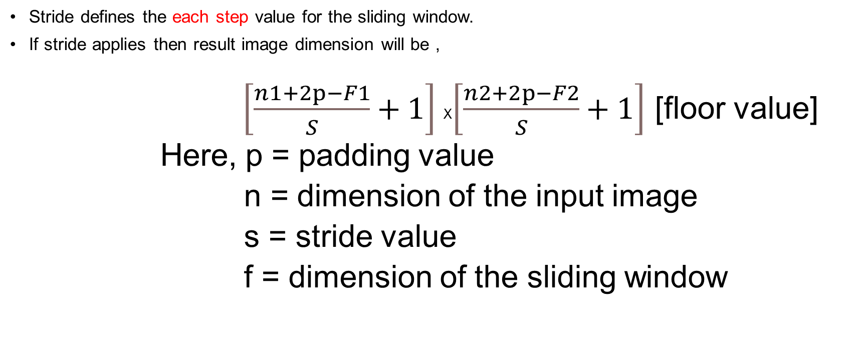
Stride:
Stride defines the each step value for the sliding window.
If stride applies then result image dimension will be ,
$\left[\frac{n1+2p−F1}{S}+1\right]$X$\left[\frac{n2+2p−F2}{S}+1\right]$ [floor value]
Here, p = padding value
n = dimension of the input image
s = stride value
f = dimension of the sliding window

Slide 15
Pooling Layer :
Reduce the image size.
Thus, reduce the computation cost
Max value carries the max intensity of the features.
->That’s why its enhances the features.
Improve the performance
No training requires
Simple transformation process
No parameter to learn

Slide 16
Before Max Pooling
After Max Pooling
Max Pooling

Slide 17
Convolutional Layer
Max pooling
3
3
Number of channel of Convolutional layer remains same after pooling

Slide 18
Max And Average Pooling
8 | 1 | 3 | 6
3 | 2 | 2 | 1
5 | 0 | 7 | 1
2 | 4 | 9 | 7
S = 2
8 | 6
5 | 9
3.5 | 3
2.8 | 6
MAX Pooling
Average Pooling

Slide 19
Fully Connected layer
The output from the convolutional and pooling layers is flattened and passed to fully connected layers
These layers make predictions based on the high-level features extracted by the convolutional layers.
Activation Function like Softmax and Sigmoid is applied to the output.

Slide 20






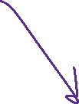

Fully Connected Layer
Here number of neurons = number of category
Flatten
Here use an activation function to classification
1D vector
Accts as an array input

Slide 21
Dense network of neurons
Applied after convolutional layer
Classifies the Output
Associate features to a particular label

Slide 22
CNN Architecture

Slide 23

Its Applied not for all time
Conv1
Max Pooling
2 X 2
S = 2
Flatten
5 X 5 X 3 X 4
14 X 14 X 4
After filtering
28X28X4
Filter
32 X 32 X 3
Cost Function
Y_prediction
BinaryCrossEntropy/
CategiricalCrossEntropy
Sigmoid / Softmax
1D -Vector
Back Propagation
14*14*4 = 784
Use Tancerflow Framework

Slide 24
Advantages :
Effective for large Image:
Pooling operations reduce the spatial dimensions, making CNNs scalable to large images, as they are less prone to the curse of dimensionality.
Automatic Feature Extraction:
CNNs automatically learn the most relevant features from the input image. Unlike traditional image processing methods, where features must be manually defined, CNNs learn them from the data itself.

